Slide 1
Chapter 16
DATA SECURITY, PRIVACY AND DATA MINING
Cios / Pedrycz / Swiniarski / Kurgan
Presented by: Humera Aamreen

Slide 2
Outline
Privacy in Data Mining
  Main mechanisms: data sanitation, data distortion, cryptographic methods
Privacy versus data granularity
Distributed Data Mining
Granular Interfaces
Collaborative Clustering
Proximity Clustering
Individual privacy v/s Collection privacy
© 2007 Cios / Pedrycz / Swiniarski / Kurgan

Slide 3
Privacy in Data Mining
Issues of privacy and security are essential to various pursuits of data mining as they involve data (accessibility and possible reconstruction of data record)
data sanitation
data distortion
cryptographic methods
© 2007 Cios / Pedrycz / Swiniarski / Kurgan
Notes:
The main aim of preserving privacy in data mining is to modify the data in such a way as to perform the data mining algorithms effectively without compromising the security contained in the data
The problem with Data mining is that with the availability of non-sensitive information, one is able to infer sensitive information that is not to be disclosed.
Thus privacy is becoming an increasingly important issue in many data mining applications

Slide 4
Data Sanitation
Modify the data so that some data points deemed sensitive cannot be directly data mined. It is anticipated that such modification of data is not going to significantly impact the main findings in the data given the total volume of data.
© 2007 Cios / Pedrycz / Swiniarski / Kurgan

Slide 5
Data Sanitaion –
MDSRRC Algorithm
Algorithm steps:
Generate the Association Rules
Specify the Sensitive rules
Obtain the frequency of each data item from the sensitive rules
Compute the sensitivity of Transactions
Find the frequency of each item present in the RHS of sensitive rules
If two items have same count then sort these in descending order of their actual support count as IS = {is0,is1,is2..}
The data item is0 with highest sensitivity is selected
The transaction containing is0 with highest sensitivity is selected and is0 is deleted from that transaction
If two transactions have same sensitivity then sort them in increasing order of their length
Update the support and confidence of all sensitive rules
From Nikunj H. Domadiya, Udai Pratap Rao, "Hiding Sensitive Association Rules to Maintain Privacy and Data Quality in Database", 3rd IEEE InternationalAdvance Computing Conference IEEE, 2013.

Slide 6
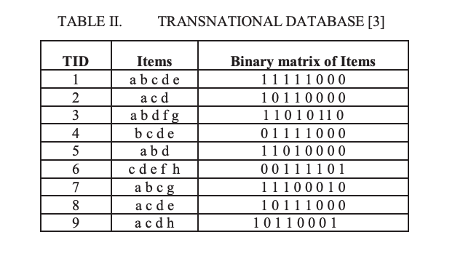
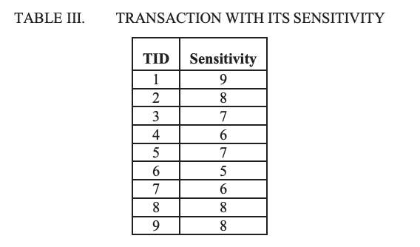
Data Sanitation -Example
The Association Rules generated by the Apriori algorithm are:
a→b, b→a, a→c, c→a,a→d, d→a,b→c, c→b, b→d, d→b, c→d, d→c, c→e, e→c,d→e,e→d,a→cd, c→ad, ac→d, d→ac, ad→c, cd→a, c→de, d→ce,cd→e, e→cd, ce→d, de→c, a→bd, b→ad, ab→d, ad→b and bd→a
If the data owner specifies the rules a→bd, a→cd and d→ac as sensitive rules..
From Nikunj H. Domadiya, Udai Pratap Rao, "Hiding Sensitive Association Rules to Maintain Privacy and Data Quality in Database", 3rd IEEE InternationalAdvance Computing Conference IEEE, 2013.

Slide 7
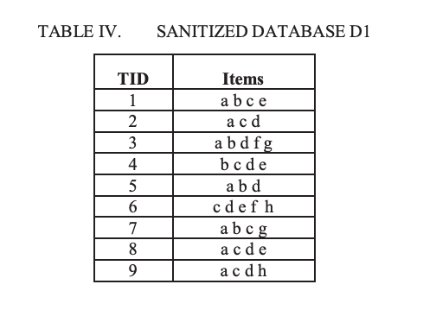
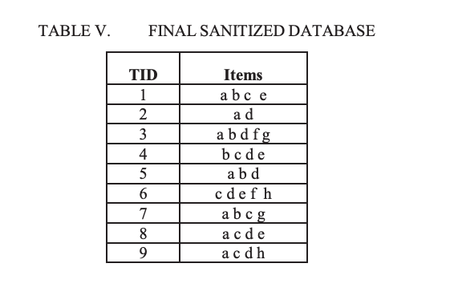
Data Sanitation – Example
From Nikunj H. Domadiya, Udai Pratap Rao, "Hiding Sensitive Association Rules to Maintain Privacy and Data Quality in Database", 3rd IEEE InternationalAdvance Computing Conference IEEE, 2013.

Slide 8
Data Distortion
Refereed to as data perturbation or data
randomization offers privacy by some modification of individual data record.
While the distortion affects the values of the individual records, its impact on the discovery and quantification of some main relationships could be still quite negligible.
© 2007 Cios / Pedrycz / Swiniarski / Kurgan
Notes:
These techniques use the distortion methods to modify the data in such a way that the true value of the individual record is difficult to ascertain while the global properties of the data remain largely unchanged.

Slide 9
Data perturbation techniques
Swapping values between records
Replacing the original database by a sample from the same distribution
Adding noise to the values in a database
Adding noise to the results of a query
Sampling the results of a query
From Rakesh Agrawal , Ramakrishnan Srikant, Privacy-preserving data mining, Proceedings of the 2000 ACM SIGMOD international conference on Management of data, p.439-450, May 15-18, 2000, Dallas, Texas, USA

Slide 10

Data Randomization - Example
Alice’s age
30 | 70K | ...
50 | 40K | ...
...
Add random number to Age
Randomizer
Randomizer
65 | 20K | ...
25 | 60K | ...
...
30 becomes 65 (30+35)
Reconstruct
Distribution
of Age
Reconstruct
Distribution
of Salary
...
Classification
Algorithm
Model
From https://www.cs.purdue.edu/homes/clifton/DistDM/Clifton_PPDM.ppt
Notes:
Another example is for Randomization for Association rules. If a client has set of items (transactions) ex- product preferences and the server wants to determine all item sets whose support is below some threshold then to preserve privacy in such scenario, the transactions are randomized by discarding some items and inserting new items, which are then transmitted to the server. The server then estimates the support and variances by looking at the randomized transactions
However, one weakness of using Data Distortion for preserving Data privacy is that under certain conditions, randomization does not prevent an attacker from reconstructing original data with reasonably high probability.

Slide 11
Cryptographic Methods
Different techniques from cryptography are considered so that the original data are not revealed during the data mining process.
Cryptographic techniques are commonly used in secure multi-party computation in which one is provided with techniques that allow multiple parties to join computing while learning nothing except for the final result of the combined activity.
Cryptographic methods come with a high communication and computational overhead -- those costs could be quite prohibitive especially when dealing with large datasets.
© 2007 Cios / Pedrycz / Swiniarski / Kurgan

Slide 12
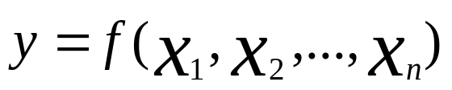
Secure Multiparty Computation
Given a function f and n inputs distributed at n sites, compute the result
without revealing to any site anything
except its own input(s) and the result.
From Chris Clifton , Murat Kantarcioglu , Jaideep Vaidya , Xiaodong Lin , Michael Y. Zhu, Tools for privacy preserving distributed data mining, ACM SIGKDD Explorations Newsletter, v.4 n.2, p.28-34, December 2002

Slide 13
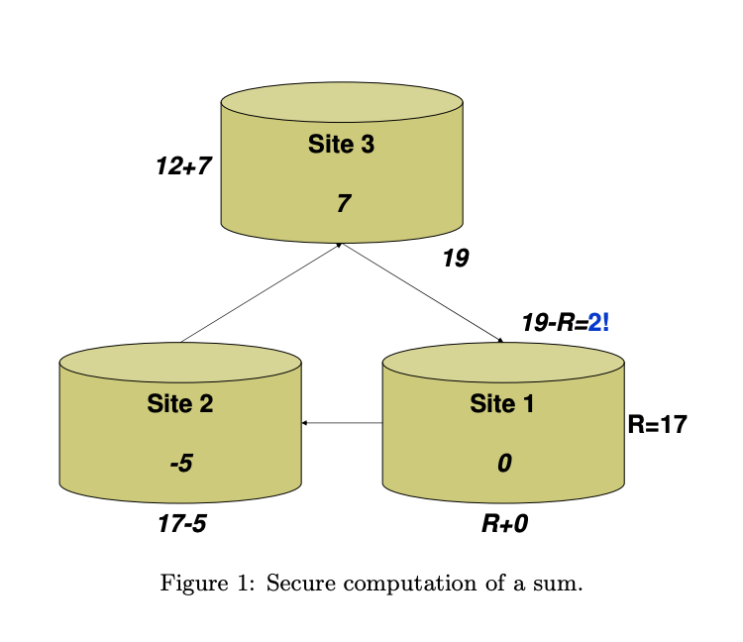
Secure Multiparty Computation
From Chris Clifton , Murat Kantarcioglu , Jaideep Vaidya , Xiaodong Lin , Michael Y. Zhu, Tools for privacy preserving distributed data mining, ACM SIGKDD Explorations Newsletter, v.4 n.2, p.28-34, December 2002

Slide 14
Cryptographic Methods:
Distributed Dot Product
Given:
a = [a₁ a₂ … a_{n}]^{T} and b= [b₁ b₂ … b_{n}]^{T}
of high dimensionality, dim (a) = dim (b) = n and
located at two sites, say A and B.
d(a, b) = a^{T}a + b^{T}b + a^{T}b
Compute the dot product of a and b using a small number of messages being sent between the sites (A and B)
© 2007 Cios / Pedrycz / Swiniarski / Kurgan

Slide 15
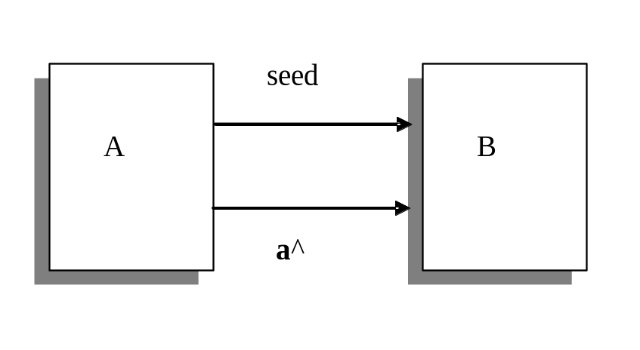
Cryptographic Methods:
Distributed Dot Product
The essence of the method :
send short k-dimensional (k <<n) messages instead of the original n-dimensional vectors a and b.
© 2007 Cios / Pedrycz / Swiniarski / Kurgan

Slide 16


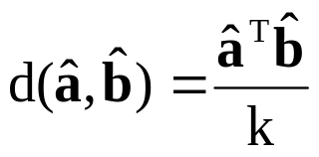
Distributed Dot Product:
Algorithm
The algorithm of computing a^{T}b works as follows
A sends B a seed of the random number generator
both A and B generate k by n matrix R populated by the entries coming from the random number generator (the generator produces numbers that are generated independently from some fixed distribution with zero mean and finite variance). At the sites computed are the vectors
B computes the expression
© 2007 Cios / Pedrycz / Swiniarski / Kurgan

Slide 17
Privacy Versus Levels of Information
Granularity
All possible interaction could be realized through some interaction occurring at the higher level of abstraction delivered by information granules.
In objective function based fuzzy clustering, there are two important facets of information granulation conveyed by
partition matrices, and
(b) prototypes.
© 2007 Cios / Pedrycz / Swiniarski / Kurgan
Notes:
Information Granules form an abstract and efficient characterization of large volumes of data at higher level of abstraction

Slide 18
Information Granularity:
Partition Matrices and Prototypes
Partition matrices: a collection of fuzzy sets which reflect the nature of the data. Detailed numeric information is not revealed.
Prototypes: reflective of the structure of data and form a summarization of data. Given a prototype, detailed numeric data remains hidden
© 2007 Cios / Pedrycz / Swiniarski / Kurgan

Slide 19
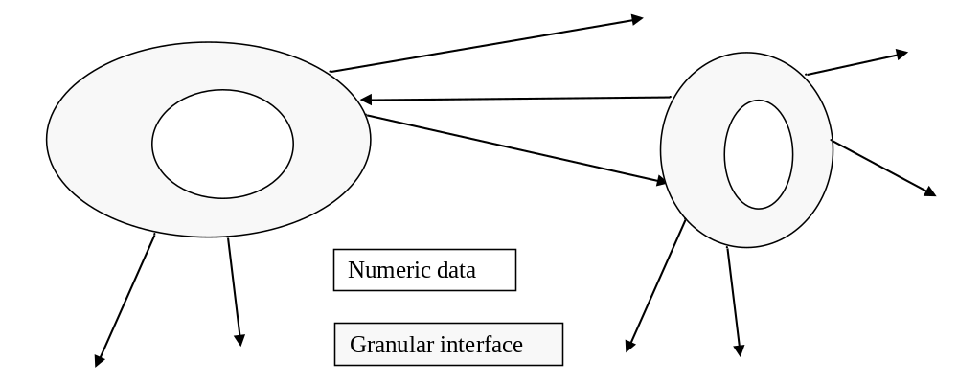
Granular Interfaces
© 2007 Cios / Pedrycz / Swiniarski / Kurgan
Notes:
The level of Information granularity is linked with the level of detail and if the level of granularity changes, possible privacy leaks could occur.
For example, if the number of clusters become equal to the number of data points then the prototypes that describe the structure could now be revealing the data point and hence no privacy is retained.

Slide 20
Distributed Data Mining
We encounter situations where databases are distributed rather than centralized:
different outlets of the same company which operate independently and collect data about customers by populating their independent databases: banking, health care, sensor networks…
Under these circumstances, the “standard” data mining activities are to be revisited:
processing all data in a centralized manner cannot be exercised,
data mining of each of the individual databases could benefit from availability of findings coming from others.
© 2007 Cios / Pedrycz / Swiniarski / Kurgan

Slide 21
Distributed Data Mining:
General Modes
The technical constraints and privacy issues dictate a certain level of interaction.
Two general modes of interaction:
collaborative clustering
consensus clustering
© 2007 Cios / Pedrycz / Swiniarski / Kurgan
Notes:
Collaborative clustering – positioned on the more active side where the clusters are revealed in a more collective manner through some ongoing interaction
Consensus clustering – focused on reconciliation of the findings where there is no active involvement at the stage of forming clusters
Both of which aim to achieve Data mining in a distributed environment
The main difference between the two lies in the level of interaction.

Slide 22
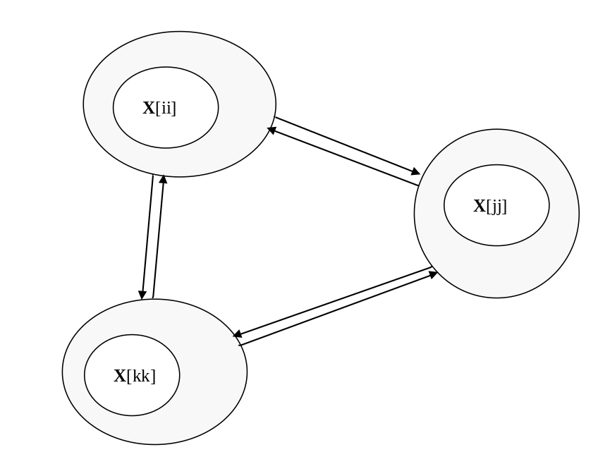
Collaborative Clustering
Communication through:
partition matrices – horizontal mode of collaboration
prototypes – vertical mode of collaboration
© 2007 Cios / Pedrycz / Swiniarski / Kurgan

Slide 23
Two Modes of Collaborative Clustering
Consider data sites X[1], X[2], .. X[p]
“P” denotes the number of data sites
X[ii] - ii-th data set (square brackets identify a certain data set)
horizontal clustering : the same objects described in different feature spaces.
Example: the collection of the same patients coming with their records built within each medical institution.
vertical clustering: data sets are described in the same feature space but deal with different patterns.
Example: clients of different branches of the same institution described in the same way (the same feature space)
© 2007 Cios / Pedrycz / Swiniarski / Kurgan

Slide 24
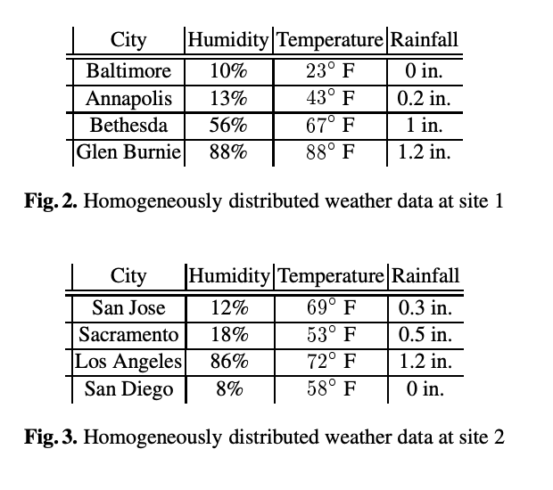
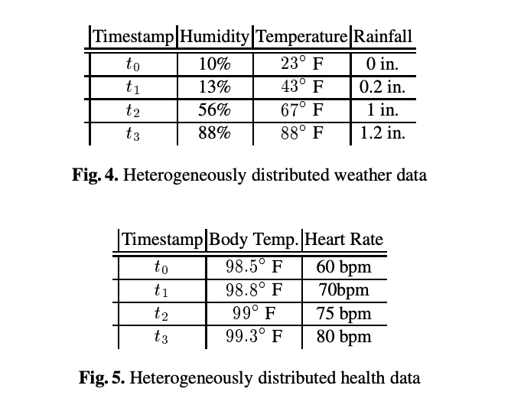
Two modes of Collaborative Clustering
From Josenildo C. Da Silva2, Chris Giannella1, Ruchita Bhargava3, Hillol Kargupta1;4, And Matthias Klusch, “Distributed Data Mining And Agents”, IEEE Conference,2005. P.T.Kavitha Et Al. / International Journal On Computer Science And Engineering (Ijcse) Issn : 0975-3397 Vol. 3 No. 12 December 2011 3852.

Slide 25
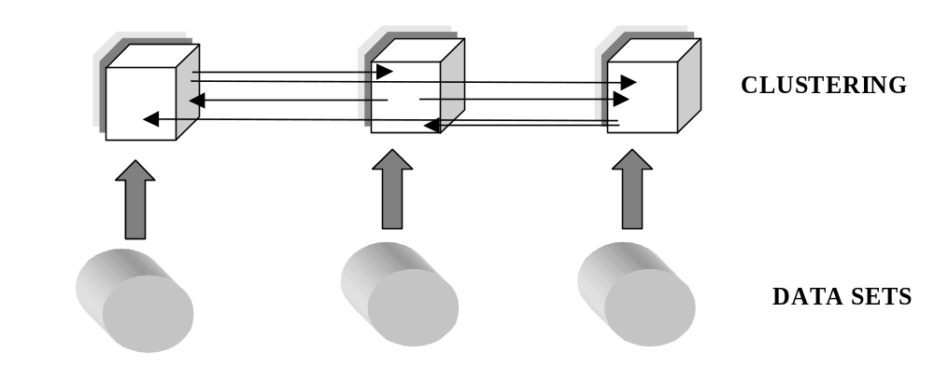
Horizontal Clustering
© 2007 Cios / Pedrycz / Swiniarski / Kurgan
Notes:
This figure depicts the fact that any possible collaboration can occur at the structural level through the Information Granules (clusters) built over the data
All communication is realized through granular interfaces

Slide 26
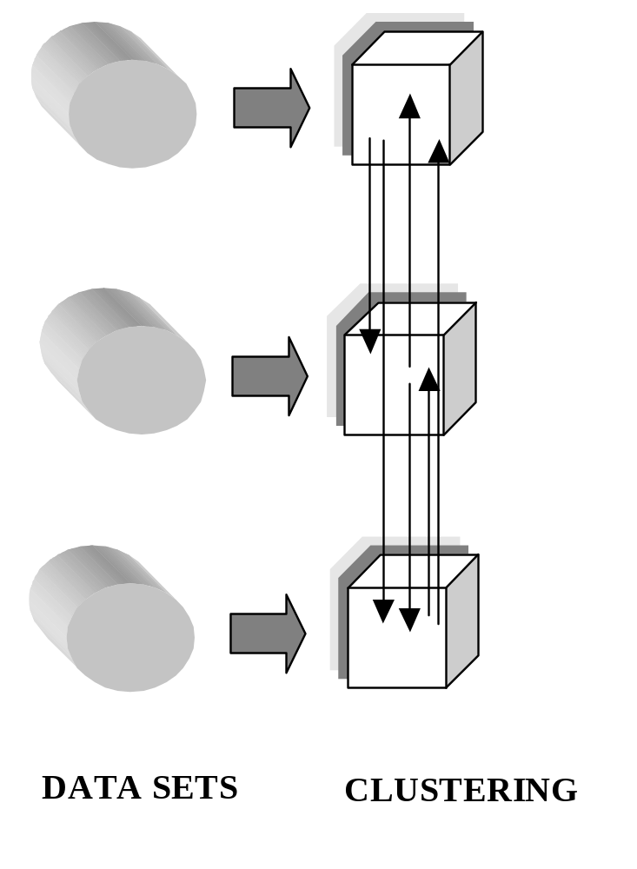
Vertical Clustering
© 2007 Cios / Pedrycz / Swiniarski / Kurgan
Notes:
Vertical Clustering is complementary to the previous one. Here, the data sets are described in the same feature space, but deal with different pattern.
All communication are realized through granular interfaces.

Slide 27
Collaborative Clustering:
Key Features
The databases are distributed and there is no sharing of their content in terms of the individual records. This restriction is caused by some privacy and security concerns. The communication between the databases can be realized at the higher level of abstraction
Given the existing communication mechanisms, the clustering realized for the individual datasets takes into account the results about the structures of other datasets and actively engages them in the determination of the clusters; hence the term of collaborative clustering
© 2007 Cios / Pedrycz / Swiniarski / Kurgan

Slide 28
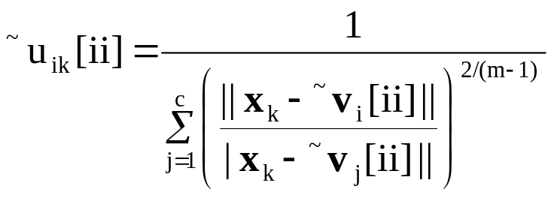
Vertical Mode of Clustering:
Algorithmic Developments
Consider fuzzy clustering FCM completed separately for each dataset.
The resulting structures represented by the prototypes are denoted by ~v1[ii], ~v2[ii], …, ~vc[ii] for the ii-the dataset and ~v1[jj], ~v2[jj], …, ~vc[jj].
Consider the ii-th data set:
© 2007 Cios / Pedrycz / Swiniarski / Kurgan

Slide 29
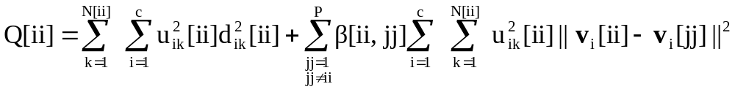
Vertical Mode of Clustering:
Augmented Objective Function
Collaboration with other data sites
“standard” FCM
© 2007 Cios / Pedrycz / Swiniarski / Kurgan

Slide 30
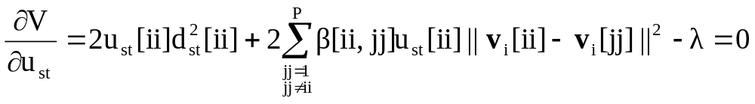
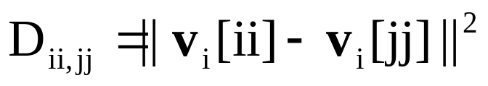
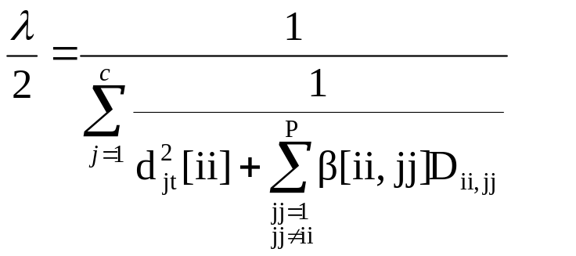
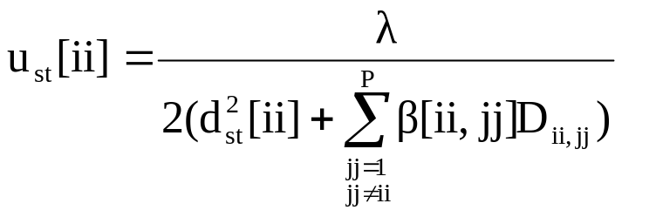
Vertical Mode of Clustering:
Detailed Derivations (1)
Introduce notation:
© 2007 Cios / Pedrycz / Swiniarski / Kurgan

Slide 31
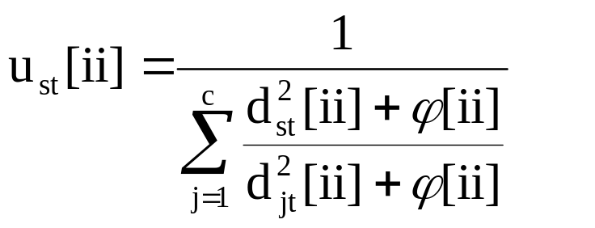
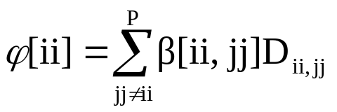
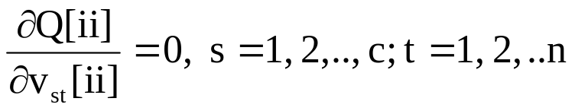
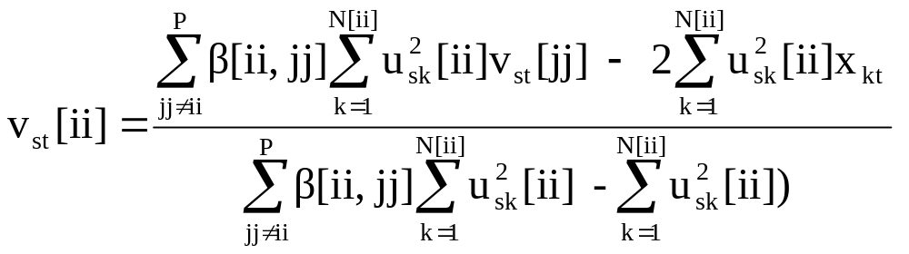
Vertical Mode of Clustering:
Detailed Derivations (2)
© 2007 Cios / Pedrycz / Swiniarski / Kurgan

Slide 32
Consensus-Based Clustering
Consensus-based clustering focuses mainly on the reconciliation of differences between the individually developed structures.
As of now, we are concerned with a collection of clustering methods being run on the same dataset.
Hence U[ii], U[jj] stand here for the partition matrices produced by the corresponding clustering method.
© 2007 Cios / Pedrycz / Swiniarski / Kurgan

Slide 33
Consensus-Based Clustering
Alleviating this problem: develop consensus at the level of the partition matrix and the proximity matrices being induced by the partition matrices associated with other data.
The use of the proximity matrices helps eliminate the need to identify correspondence between the clusters and handle the cases where there are different numbers of clusters used when running the specific clustering method. .
© 2007 Cios / Pedrycz / Swiniarski / Kurgan

Slide 34
Consensus-Based Clustering
Determination of some correspondence between the prototypes (partition matrices) formed for by each clustering method becomes crucial
There are no linkages between them once the clustering has been completed. The determination of the correspondence is an NP complete problem and this limits the feasibility of finding an optimal solution.
© 2007 Cios / Pedrycz / Swiniarski / Kurgan

Slide 35
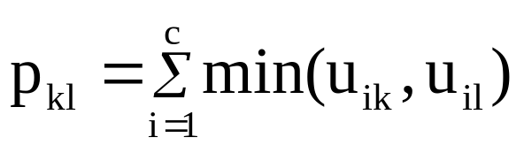
Proximity Matrix
Given is partition matrix U = [u_{ik}]
Proximity matrix P = [p_{kl}] is built on a basis
of two columns (k and l) of U
Properties of proximity matrix
p_{kk} =1 reflexivity
p_{kl} = p_{lk} symmetry
© 2007 Cios / Pedrycz / Swiniarski / Kurgan

Slide 36
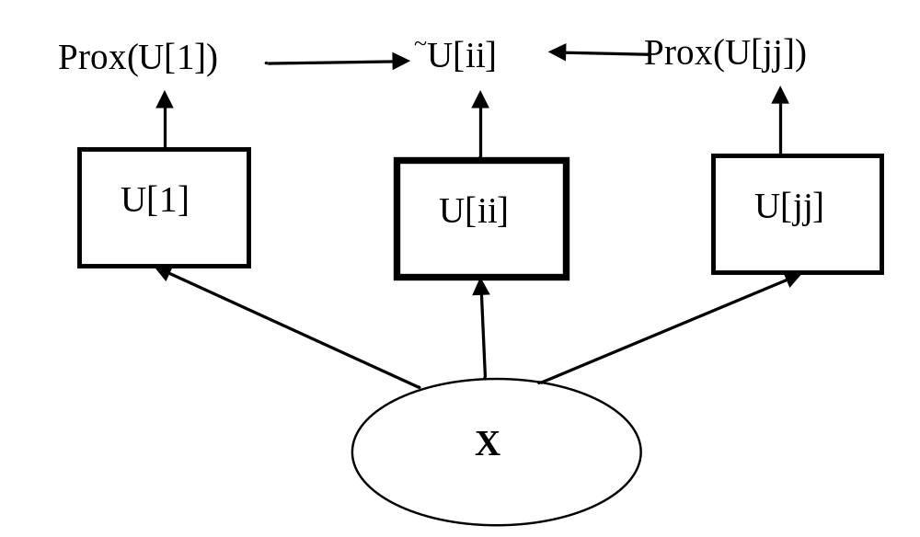
Consensus-Based Clustering:
Architecture
© 2007 Cios / Pedrycz / Swiniarski / Kurgan

Slide 37
Consensus-Based Clustering:
Objective Function
Min wrt. ~U[ii]
Fuzzy partition matrix
to be optimized
Partition matrix associated with
data site “jj”
© 2007 Cios / Pedrycz / Swiniarski / Kurgan

Slide 38
Privacy and Security Constraints
Individual Privacy
  Nobody should know more about any entity after the data mining than they did before
Organization Privacy
  Protect knowledge about a collection of entities
    Individual entity values may be known to all parties
    Which entities are at which site may be secret
© 2007 Cios / Pedrycz / Swiniarski / Kurgan

Slide 39
Privacy Preserving Data Mining
Government / public agencies. Example:
  The Centers for Disease Control want to identify disease outbreaks
  Insurance companies have data on disease incidents, seriousness, patient background, etc.
  But can/should they release this information?
Multinational Corporations
  A company would like to mine its data for globally valid results
  But national laws may prevent transborder data sharing
Public use of private data
  Data mining enables research studies of large populations
  But these populations are reluctant to release personal information
© 2007 Cios / Pedrycz / Swiniarski / Kurgan

Slide 40
Individual Privacy:
Protect the “record”
Individual item in database must not be disclosed
Not necessarily a person
  Information about a corporation
  Transaction record
Disclosure of parts of record may be allowed
  Individually identifiable information
© 2007 Cios / Pedrycz / Swiniarski / Kurgan

Slide 41
Collection Privacy
Disclosure of individual data may be okay
  Telephone book
  De-identified records
Releasing the whole collection may cause problems
  Trade secrets – corporate plans
  Rules that reveal knowledge about the holder of data
© 2007 Cios / Pedrycz / Swiniarski / Kurgan

Slide 42
Privacy Rules
Primarily national laws
  European Union General Data Protection Regulation (GDPR)
  US HIPAA rules (www.hipaadvisory.com)
  Many others: (www.privacyexchange.org)
Often control transborder use of data
Focus on intent
  Limited guidance on implementation
© 2007 Cios / Pedrycz / Swiniarski / Kurgan

Slide 43
EU GDPR
Came into force on May 25th, 2018
Designed to modernize laws that protect the personal information of individuals
GDPR alters how businesses and public sector organizations can handle the information of their customers.
It also boosts the rights of individuals and gives them more control over their information.
In the full text of GDPR, there are 99 articles setting out the rights of individuals and obligations placed on organizations covered by the regulation.
There are eight rights for individuals. These include allowing people to have easier access to the data companies hold about them, a new fines regime and a clear responsibility for organisations to obtain the consent of people they collect information about.
© 2007 Cios / Pedrycz / Swiniarski / Kurgan

Slide 44
US Healthcare Information Portability and Accountability Act (HIPAA)
Governs use of patient information
  Goal is to protect the patient
  Basic idea: Disclosure okay if anonymity preserved
Regulations focus on outcome
  A covered entity may not use or disclose protected health information, except as permitted or required…
    To individual
    For treatment (generally requires consent)
    To public health / legal authorities
  Use permitted where “there is no reasonable basis to believe that the information can be used to identify an individual”
Safe Harbor Rules
  Data presumed not identifiable if 19 identifiers removed (§ 164.514(b)(2)), e.g.:
    Name, location smaller than 3 digit postal code, dates finer than year, identifying numbers
  Shown not to be sufficient
© 2007 Cios / Pedrycz / Swiniarski / Kurgan

Slide 45
References
Cios, K.J., Pedrycz, W. and Swiniarski, R. 1998. Data Mining Methods for Knowledge Discovery. Kluwer
Da Silva, JC, Giannella, C., Bhargava, R, Kargupta, H. and Klusch, M.2005. Distributed data mining and agents, Engineering Applications of Artificial Intelligence, 18, 7, 791-807
Pedrycz, W. 2005.Knowledge-Based Clustering: From Data to Information Granules, J. Wiley
Verykios, VS., Bertino,E., Fovino IN, Provenza, LP. Saygin, Y and Theodoridis Y. 2004. State-of-the-art in privacy preserving data mining. SIGMOD Record 33, 1, 50–57
Wang; K. Yu, PS and Chakraborty, S. 2004. Bottom-up generalization: a data mining solution to privacy protection, Proc.. 4th IEEE International Conference on Data Mining, ICDM 2004, 249 - 256
© 2007 Cios / Pedrycz / Swiniarski / Kurgan

